Slide 1


CSE 593
Dr. Yinong Chen

Slide 2
Design Process
Define Problem
Requirement
Specification
Generate
Solutions
Budget
Proposal
Plan
Plan
Decide Course
of Action
Task Schedule
Approval
Cost / Spending
Plan
Plan
Implementation
Tasks - Timing
Carry Though
Follow Up
Final
Evaluation
Dr. Yinong Chen

Slide 3
Budget Preparation
Your budget must conform to your technical description
The budget narrative should answer all the questions a skeptical reviewer would ask;
Go through the narrative and highlight every activity that has financial implications — make a list of everything that will have to be paid for;
Assign each one of those costs to an appropriate budget category —
  Personnel
  Equipment, materials and supplies
  Telecommunications, travel,
  Services, publications…
Dr. Yinong Chen

Slide 4
Budget Preparation
Your budget must be realistic
Reviewers know what things cost; if your budget is not realistic they will think you are either dishonest or stupid;
A budget that is too low may make it impossible to complete the project, which will jeopardize your chances for funding or future funding
Estimate costs as accurately as possible:
  Get written price quotations for equipment
  Request binding agreements for subcontracts
Dr. Yinong Chen

Slide 5
Budget Preparation
Review the rules and double-check everything
Check your arithmetic — is everything added correctly?
Have you included all required information?
Has every line and every box been completed?
Dr. Yinong Chen

Slide 6
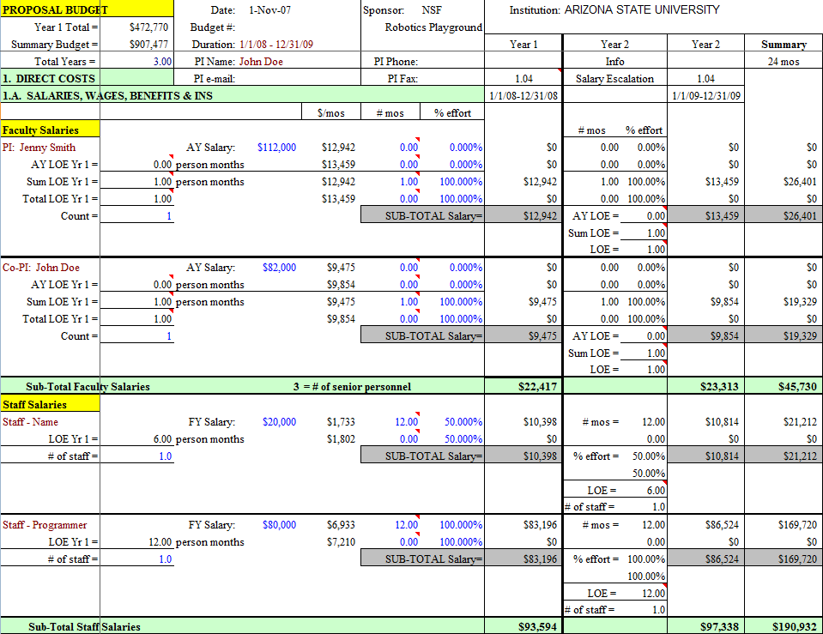
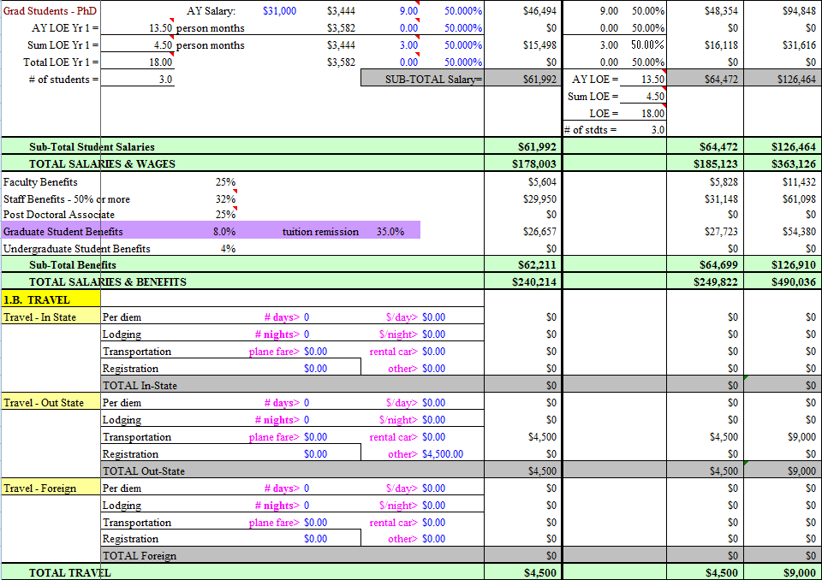
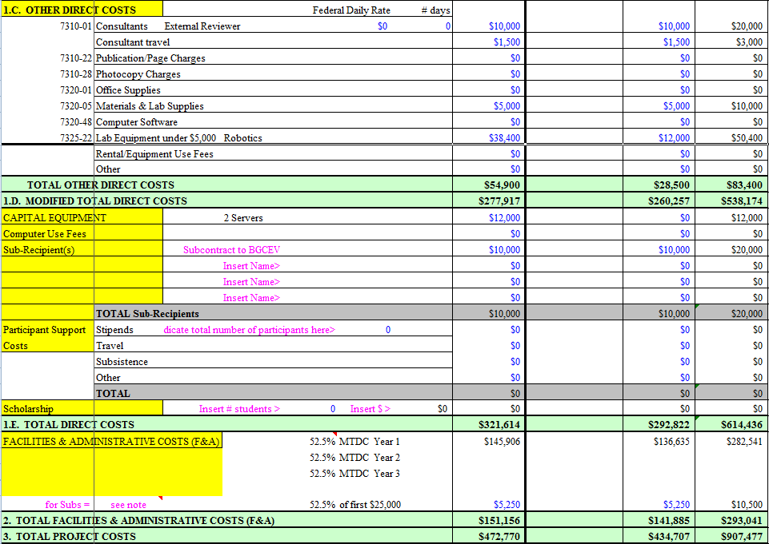
ASU Budget Example
Page 1
Page 2
Page 3
Dr. Yinong Chen

Slide 7
ASU Budget Example
Dr. Yinong Chen

Slide 8
ASU Budget Example (contd.)
Dr. Yinong Chen

Slide 9
ASU Budget Example (contd.)
Dr. Yinong Chen

Slide 10
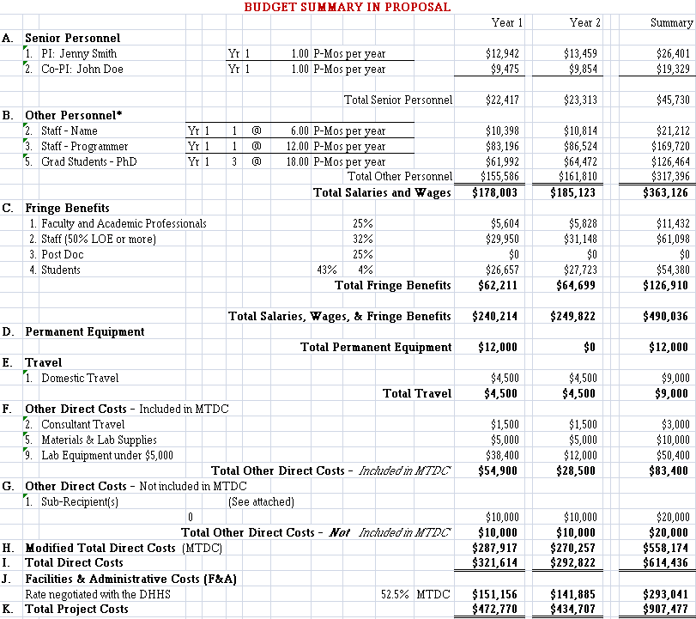
Dr. Yinong Chen

Slide 11
Other Cost Consideration:
Cost of Design Changes
Cost to implement a change
Cost increases exponentially as the project lifetime increases
Project lifetime
Dr. Yinong Chen

Slide 12
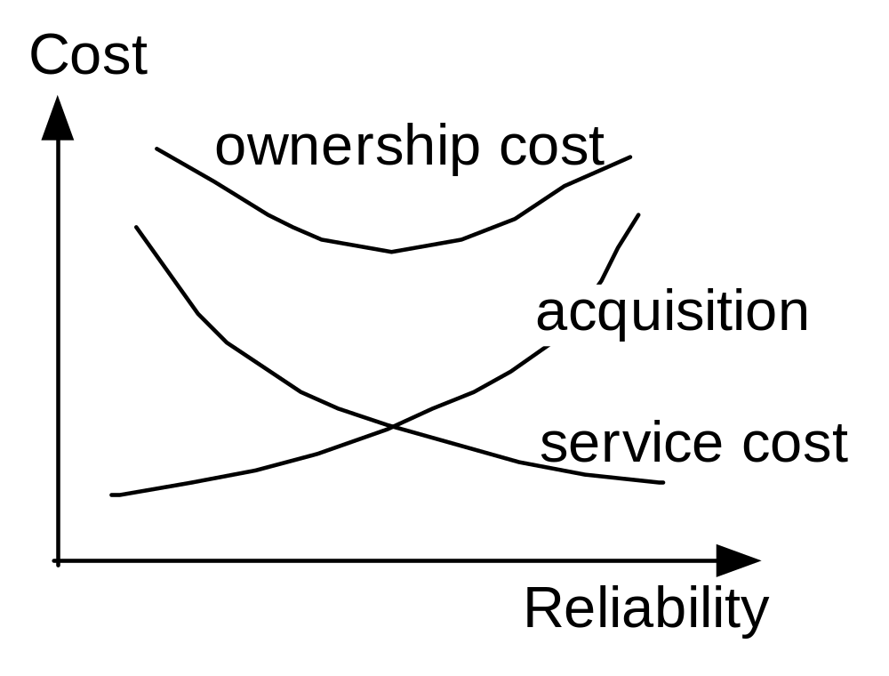
Ownership Costs of a Product
Dependability
Dr. Yinong Chen

Slide 13
Time and Resource Allocation/Plan
Proposal
Plan
Bottlenecks
Time consuming items
Approval
Time and resource allocation
Plan
Plan
Resources within budget
Critical path
management
Follow the budget
Gantt Chart
Refine the schedule in the proposal
Dr. Yinong Chen

Slide 14
Critical Paths
Critical path: from start to finish which takes most time.
Any slip in the accomplishment of an activity on the critical path will result in a slip in the finish.
Identify and prioritise the activities
Identify which activities MUST be done before others
Identify EST – Earliest Start Time
Identify LFT – Latest Finish Time
Identify the tasks that can be completed outside the critical path
Dr. Yinong Chen

Slide 15
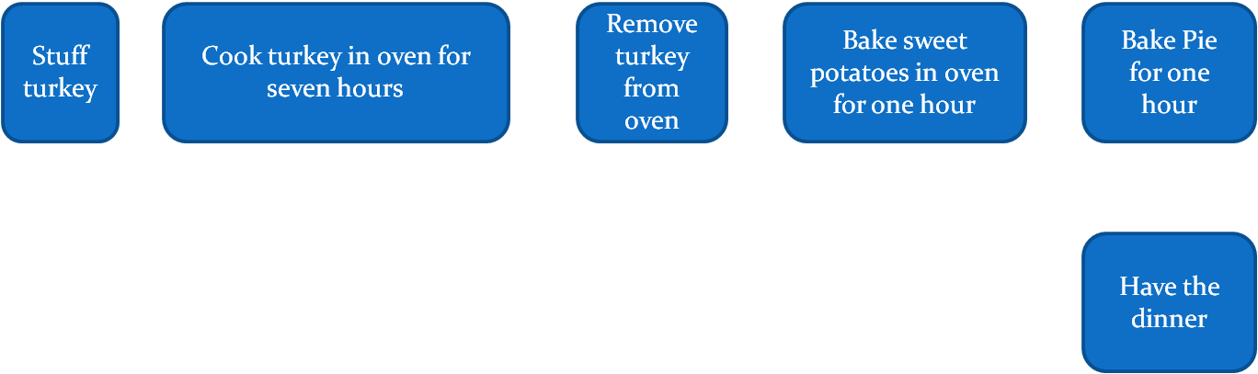
Critical Path Case Study:
Thanksgiving Dinner Project
Stuff turkey
Cook turkey in oven for
seven hours
Remove turkey from oven
Bake sweet potatoes in oven for one hour
Bake Pie for one hour
Slicing turkey
Have the dinner
Prepare potatoes
Prepare pie crust
Prepare pie filling
Add filling on crust
Clean the house
Set the table
Dr. Yinong Chen

Slide 16
Project Planning: Gantt Charts
Gantt charts are used to plan stages of the design process
Usually stages run vertically and time (e.g. calendar days) horizontally
Indicates work in progress, as well as future and past work, in relation to time
Dr. Yinong Chen

Slide 17
Gantt Chart
A detailed list of all activities/tasks that will be required through the project with corresponding target dates of completion;
Critical path management must be embedded to the chart
A Gantt chart is required for this project and should be placed in mid-term and final report
Convenient tools of creating a Gantt chart includes Excel, table feature of Word, project software
Dr. Yinong Chen

Slide 18
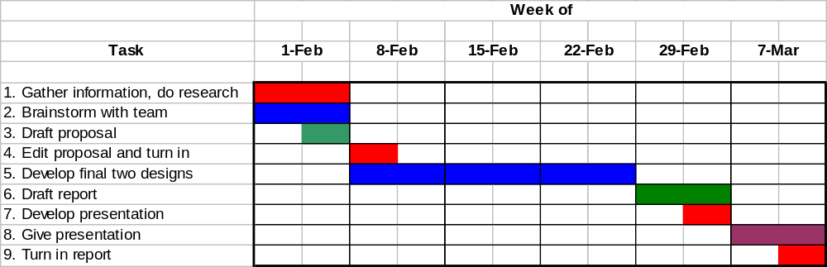
Gantt Chart Example
LFT
LFT
LFT
EST
EST
EST
Identify EST – Earliest Start Time
Identify LFT – Latest Finish Time
Critical Path
Dr. Yinong Chen

Slide 19

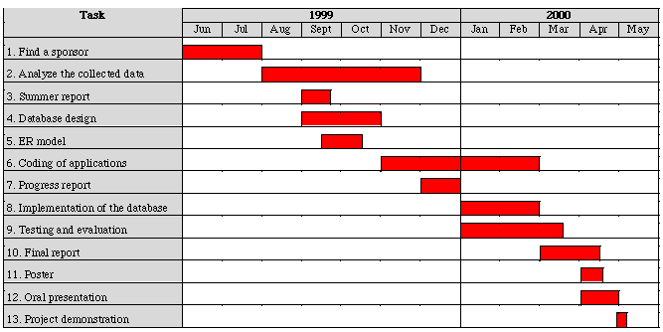
LFT
LFT
EST
EST
LFT
EST
EST
LFT
EST
EST
Identify EST – Earliest Start Time
Identify LFT – Latest Finish Time
Critical Path
Dr. Yinong Chen

Slide 20
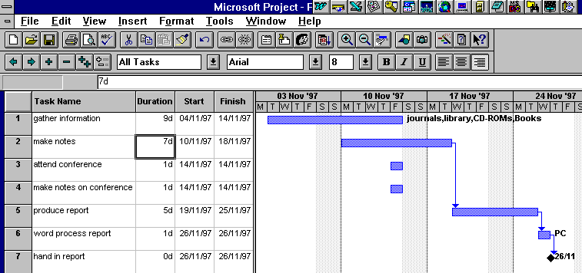
Dr. Yinong Chen

Slide 21
Tasks that should be in your Gantt chart
Problem definition and brainstorming
Research of existing and related work
Development of alternative designs
Preliminary testing of designs and decide the course of action
Design Improvements
Implementation plan of the current phase deliverable
Evaluation plan
Drafting and final revisions of documents
Due dates for documents and presentation
Dr. Yinong Chen

Slide 22
Task | 6 | 7 | 8 | 9 | 10 | 11 | 12 | 13 | 14 | 15 | 16 | 17 | 18 | 19 | 20 | 21 | 22 | 23 | 24 | 25 | 26 | 27 | 28 | 1 | 2 | 3 | 4 | 5 | 6 | 7 | 8 | 9 | 10
1. Develop alternative designs
2. Select a final design
3. Write a proposal draft
4. Have all team members review the proposal draft
5. Edit the proposal draft
6. Submit the proposal draft
7. Edit proposal draft
8. Submit proposal
9. Build design
10. Test design
11. Re-design and re-test (if necessary)
12. Write a final report draft
13. Have all team members review the final report draft
14. Edit the report draft
15. Submit the report draft
16. Edit report draft
17. Demo final design in-Lab
18. Develop presentation
19. Edit presentation (if necessary)
20. Give presentation
21. Submit final report
Sample Gantt Chart Outline
Dr. Yinong Chen

